Slide 1
How to Do HW 2:
Simulations
Using Runge-Kutta Methods of the
1st order Engine Model
ME 452 – Vehicle Dynamics, Fall 2026

Slide 2
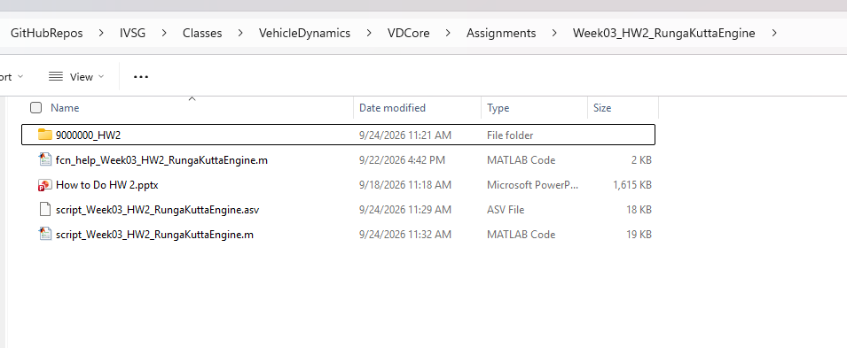
First step: create a folder to work from
In the homework assignments, we will need a place to save our scripts and, later, our own functions. By default, the “Assignments” folder and all subfolders that exist when running the main script are set to be visible to MATLAB. The suggestion for this assignment, and all future assignments, is to keep each assignment’s scripts, folders, data files in a sub-folder within each assignment. It’s suggested that the name match your Canvas student number and indicate which homework is being completed. For example, see the folder for Dr. B whose number is 9000000

Slide 3
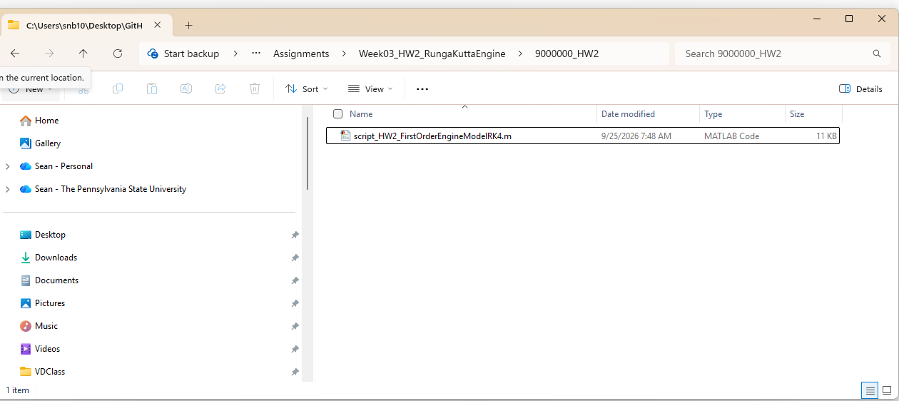
Next, open up the existing simulation from deep within Dr B’s subfolder
It’s located here. Copy it into your HW2 folder, or otherwise your edits will be lost each time you copy the repo from Dr B’s edits.

Slide 4
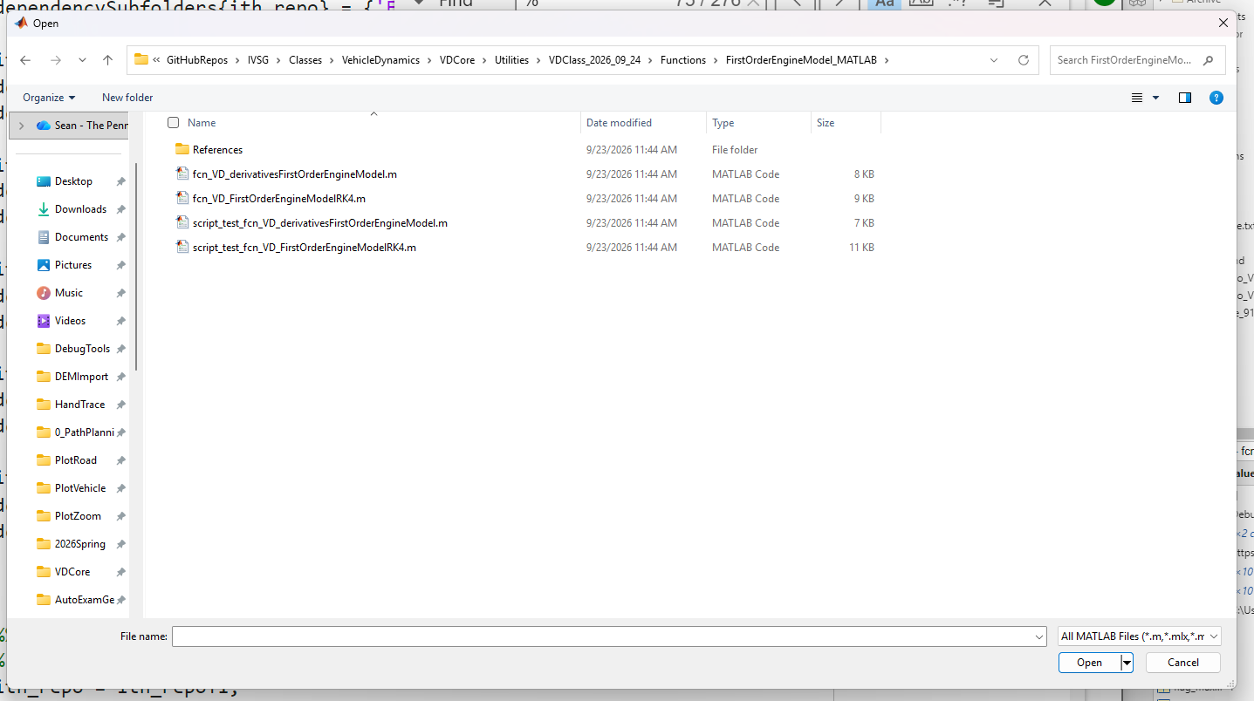
Note: this script was taken from an example from the vehicle library, which you have a copy within your Utilities subfolder
We will be using functions and scripts out of this library increasingly throughout the semester

Slide 5
Finally, you must edit and run the script that does the simulation.
% Set the simulation time/state arguments
initialStates = 0; % [Omega] in [rad/sec]
deltaT = 0.01; % Units are [sec]
startTime = 0;
endTime = 4.5;
timeInterval = [startTime endTime]; % Units are [sec]
% Set up inputs
simulationTimes = (startTime:deltaT:endTime)';
torque_amplitude_Nm = 142 ; % Newton-meters, this is for a 2013 Prius
% % Set up a sinewave input
% Period = 3; % Units are seconds. A typical lane change is about 3 to 4 seconds based on experimental highway measurements
% inputsVsTime = [simulationTimes torque_amplitude_Nm*pi/180*sin((2*pi/Period)*simulationTimes)]; % [times steering angles]
% Set up a step input
stepTorqueInput = ones(length(simulationTimes),1);
stepTorqueInput(1,1) = 0;
inputsVsTime = [simulationTimes torque_amplitude_Nm*stepTorqueInput]; % [times torques]
% Set up parameters
clear parameters
% Use the 2nd and 3rd numbers in your Canvas number to fill in J and B.
% if 2nd number is 1 then J is 1, if 2 then J is 2. If it is 0, use 10
% if 3rd number is 1 then B is 1, if then B is 2. If it is 0, use 10
parameters.J = 10; % J is the rotational inertia of the vehicle, in kg-m^2
parameters.B = 10; % B is the rotational viscous drag, in (N-m)/(rad/sec)
% Call the function
[stateTrajectory, t, inputHistory] = ...
fcn_VD_FirstOrderEngineModelRK4(initialStates, deltaT, ...
timeInterval, inputsVsTime, parameters, (figNum));
% Get the torque at the first instant at or after 1 second
timeToFind = 1.00; % Seconds
indexToUse = find(t>=timeToFind,1);
statesAtTimeToFind = stateTrajectory(indexToUse,:);
fprintf(1,'\nAt time: %.2f, the speed was: %.2f\n',timeToFind,statesAtTimeToFind(1,1));
% Dr B's result: 8.92 rad/sec. This is ~90 RPM so the engine isn't really
% running. Why is this so wrong? the viscous friciton is WAY too high
% compared to the real engine. For reference, an engine at 1000 RPM is
% about 100 rad/sec, and this value, times friction, is the steady-state
% engine loss. This should be about 10% or less of the peak torque. So we
% can see that the actual B value for the Prius is roughly 14.2 N-m / 100
% rad/sec, or about 0.14. The the number used here is 100 times too large.
% We just doing simulations, so that's OK. But we can see that it's easy to
% back-calculate core parameters in engine models even with limited
% manufacturer data.
% sgtitle(titleString, 'Interpreter','none');
sgtitle('SB','Interpreter','none');
Note: the instructions are intentionally going to become less and less clear because we’re assuming that students are getting better and better at running MATLAB scripts.
The locations that need to be edited for this assignment should be very obvious. Give it a try and ask Dr. B questions if you have problems!
The core parts that we need to edit are shown at right.

